Slide 1
Introduction
Mobile agents are programming entities that can freely roam in the network on behalf of the user. They can maintain state information and make intelligent decisions using it. The mobile agent requires an environment on potential hosts to run on.

Slide 2

Problem Statement
Most of the available distributed systems today are based on the client/server model, which is implemented through some form of remote procedure calls, or remote objects in the case of the object-based model. The client/server paradigm however, has its own limitations. Most notably, all interactions between client and server must go through the network .

Slide 3

Another approach that is forming a new paradigm for distributed computing is mobile agents. This approach is attractive since the reliability of the network connection is not crucial.

Slide 4
AIM:
Our aim is to develop a framework which makes use of network agents. It allows processes to migrate from computer to computer in a network and perform the required task on behalf of the user thus eliminating his/her continous presence.
It provides independence to the user from being online all the time.

Slide 5
An attractive area in which to use of mobile agents in processing data over unreliable networks. In such networks, the low-reliability network can be used to transfer agents, rather than a chunk of data, from place to place. In this paradigm, the agent can travel to the nodes on the network, process the information on those nodes without the risk of network disconnection and then return home. E.g. Active Mail , it can be used to send executable content as e-mail.

Slide 6


TASK FIELD
PAY-LOAD
DESTINATION ADDR.

Slide 7








Indore
Pune
Mumbai
Hyderabad

Slide 8




Work flow Comp
File I/O
Network component
Protocol component

Slide 9
Accept the agent
Read Operation
Write Operation
Decide the Protocol
Manage the Agent
Send to destination
Address
Network Component
Protocol Component

Slide 10
Algorithm
1.HOST1 creates a MOBILE AGENT.
2.On MOBILE AGENT different action can be performed: CREATE, EXECUTE, TRANSFER, TERMINATE.
3.This agent is transferred over the NETWORK.
4.The NETWORK performs two functions:
1.Identifies the state.
2.Identifies agent's attribute value.
5.NETWORK sends this MOBILE AGENT to the desired HOST (of given IP).

Slide 11
Algorithm contd..
6.On that HOST it identify the process and EXECUTE it.
7.RESULT is store on MOBILE AGENT.
8.If MOBILE AGENT has more IP to traverse then it transfer to that HOST. Otherwise go to step number 10.
9.Now steps 5 to 8 repeat for the new HOST.
10.send MOBILE AGENT to HOST1.

Slide 12
Work done till now
User InterFace Design
Transfer of task on the network
Remote execution of the transferred task
Implementation of tranfer protocol
Appending payload to the mobile agent

Slide 13
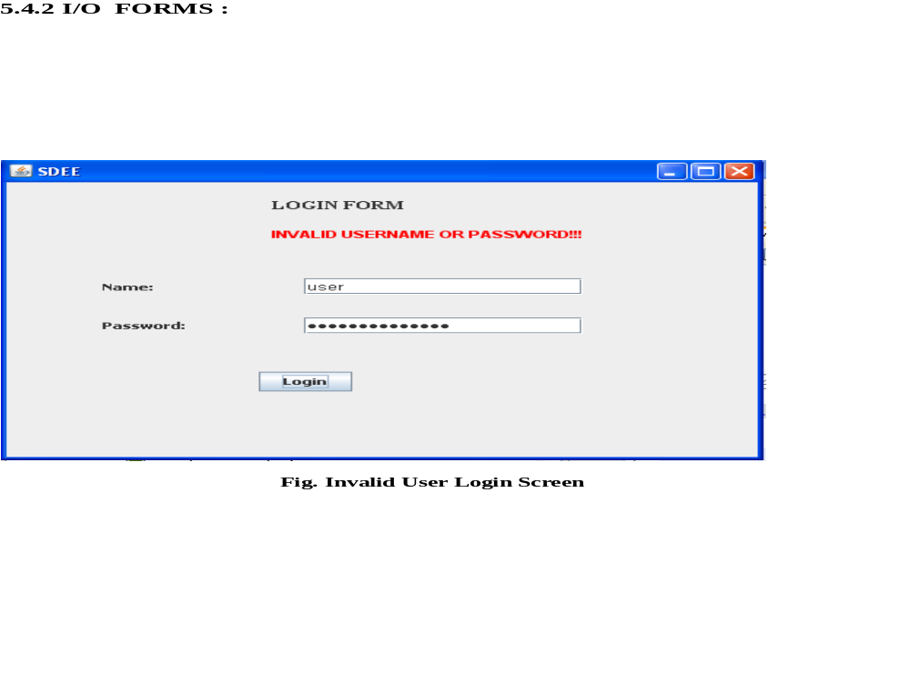
USER INTERFACE

Slide 14
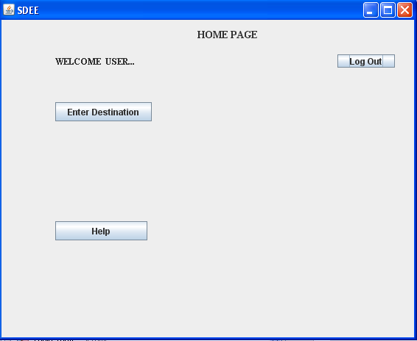

Slide 15
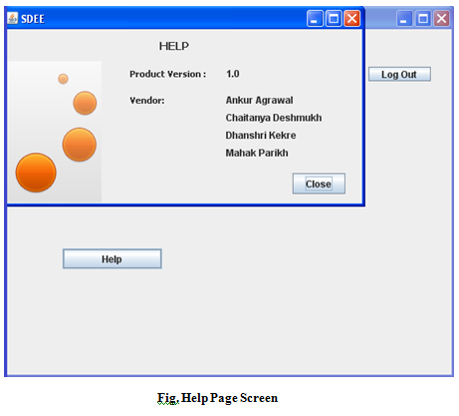

Slide 16
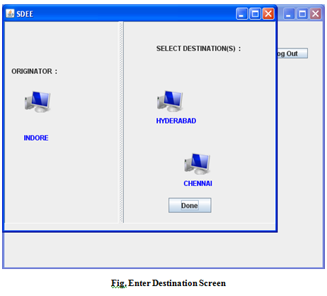

Slide 17
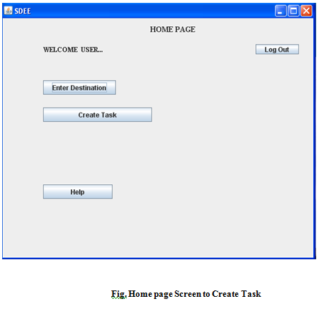

Slide 18
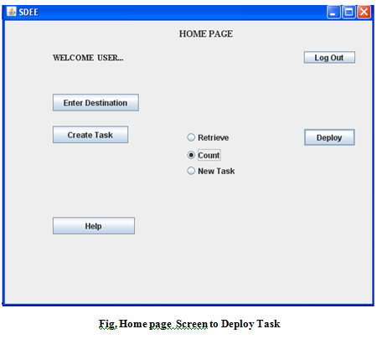

Slide 19
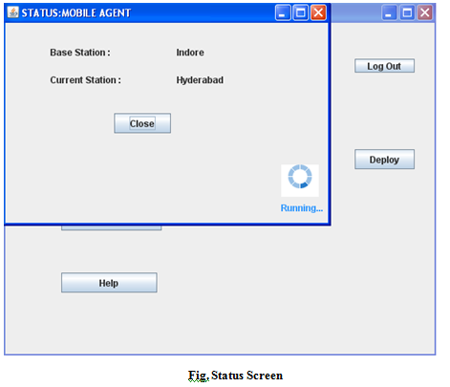

Slide 20
Work to be done
Combining the modules together in a jar file

Slide 21
FEATURES
Reliability of the network connection is not crucial.
Low Bandwidth :the locality of two entities allow them to save Bandwidth in the communication, especially if the mobile agents act as a filter and process only the data that is really useful.
Offline Processing: It offer offline processing.
Asynchronous behavior : It can easily recover from communication failures, because either the entire agent is on client or not at all .
Dynamic Adaptation: mobile agent ability to react autonomously to balance the load in the network, thus provide robustness and degree of fault tolerance .

